Slide 1
Sentiment Analysis On Tweets
By Apollo Callero

Slide 2
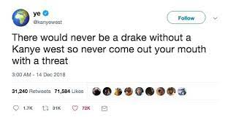

Motivation
The goal of this project is to classify tweets as ‘positive’ or ‘negative’
Positive
Negative

Slide 3
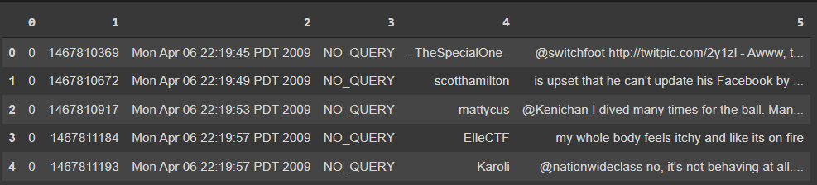
The Dataset
Used a free dataset from kaggle:Link , made by Stanford researchers
1.6 million tweets, only labeled as either positive or negative
Balanced i.e 800,000 positive tweets, 800,000 negative tweets
Assumes tweets with happy emoticons as positive and tweets with sad emoticons as negative. So any tweet with ‘;)’ is marked as positive and any tweet with ‘ ;(‘ is marked as negative

Slide 4
Data preprocessing
Remove stop words, i.e ‘was’ , ‘is’
Stem words, i.e ‘likeable’ becomes ‘like’
Treat all tags and links the same
‘@marieclr I was serious LOL’ becomes ‘___TAG____ i seriou lol’
Tokenize the all processed tweet into number
‘___TAG____ i seriou lol’ becomes [322 , 5 , 1077 , 94]

Slide 5
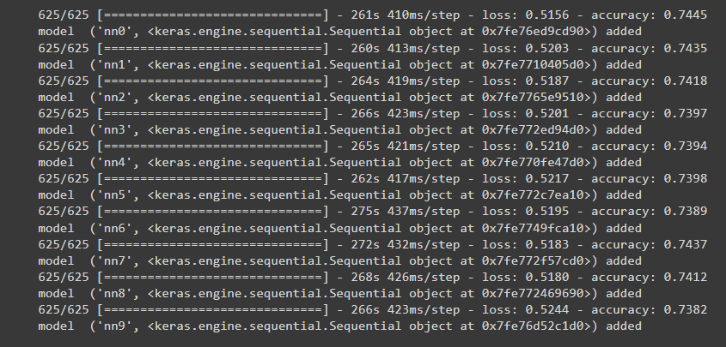
Model training
Made a basic neural net with a embedding layer, the embedding layer finds a relation between words
Used 1.5 million tweets out of 1.6 million to train 10 separate (but identical) neural nets
Used my own ‘soft’ voting bagging function

Slide 6
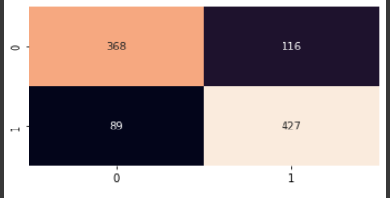
Results
While each individual model had about 74% accuracy, combining them using bagging increased the accuracy to 79.5% (only based on 1000 test points)
I’m pleased with this result because it is only 2% worse than the Stanford researchers who made the dataset

Slide 7
Next Steps
Increase accuracy by
Improve model by experimenting with different hyperparameters
Using different classifiers on top of bagging in the ensemble method
Words with many repeated Letters, Haaaaaaapy and haaapy -> haapy
Filter out sarcastic tweets ,reddit sarcasm detector
Filter out neutral tweets
Future Work
Handling tweet replies and images/videos, also would require a new dataset
The dataset only uses tweets that used emoticons, it would be interesting to see how the accuracy is affected by using tweets that don't have them

